Slide 1
CPSC 351
Operating Systems Concepts
Windows IPC
Client-Server System Communications
Threads

Slide 2
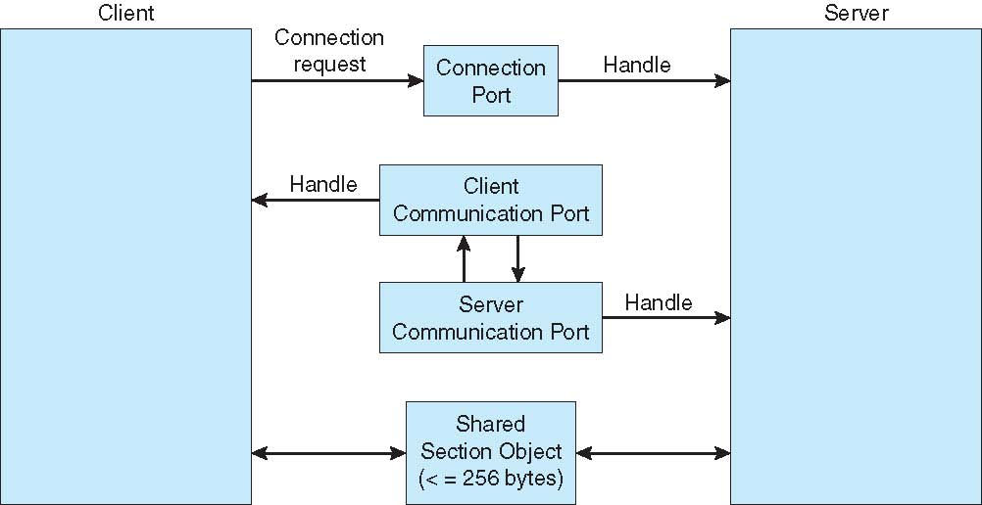
Message Passing - Windows

Slide 3
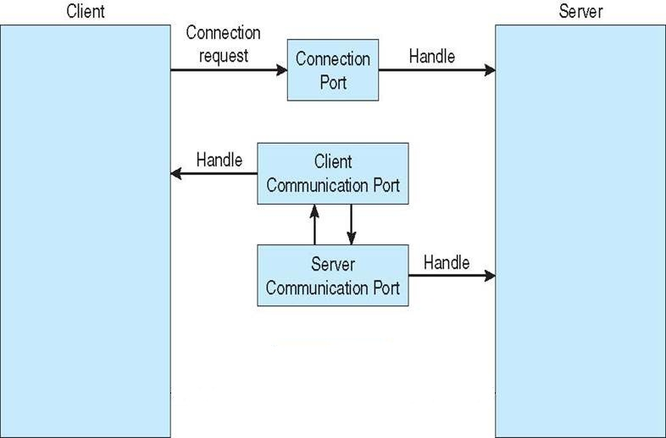
Windows IPC Systems Example
Message-passing centric via advanced local procedure call (LPC) facility
Only works between processes on the same machine
Uses ports (like mailboxes) to establish and maintain communication channels
Two types of ports
Connection ports: visible to all processes; used to set up communication ports
Communication ports: used for actual communications
Communication works as follows:
Client opens a handle to the server’s connection port object
Client sends a connection request
Server creates two private communication ports (client & sever), and returns one handle to the client
Client and server use the corresponding port handles to send messages
Server publishes connection-port objects – visible to all processes
Notes:
Consider application programs as clients of a subsystem server

Slide 4
Communications in Client-Server Systems
Sockets
Pipes
Remote Procedure Calls

Slide 5
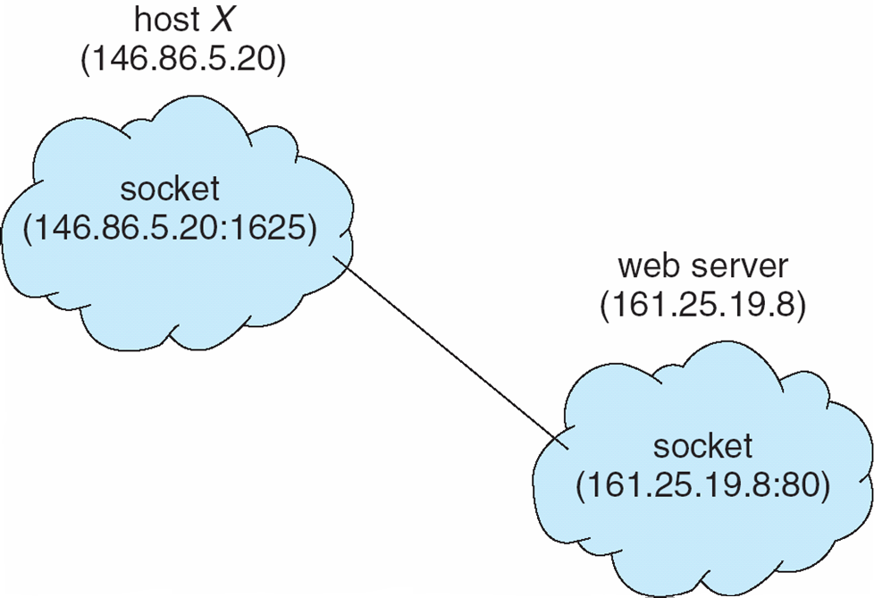
Sockets
Socket: an endpoint of communication
Concatenation of IP address and port – a number included at start of message packet to differentiate network services on a host
All ports below 1024 are well known, used for standard services
Communication consists between a pair of sockets
Special IP address 127.0.0.1 (loopback) to refer to system on which process is running
The socket 146.86.5.20:1625 refers to port 1625 on host 146.86.5.20
Notes:
Servers implement specific services such as telnet (port 23), FTP (port 21), HTTP (port 80), … on well-known ports
Server accepts a connection from the client socket to complete the connection when the server receives the request
Server listens to incoming client requests on a specified port
Client process initiates a request for a connection, its host computer assigns a port (arbitrary # greater than 1024)

Slide 6


Pipes
Which One?

Slide 7
Pipes
Pipe acts as a channel between two processes
Ordinary pipes: enable a straightforward, one-way, producer-consumer communications
A typical pipe comprises a front-end and a rear-end
Cannot be accessed from outside the process that created it
Producer (e.g., parent process) writes to the front-end of the pipe.
Consumer (e.g., child process) reads the written information from the rear-end of the pipe
Bi-directional communications require two pipes
Named pipes can be accessed without a parent-child relationship

Slide 8
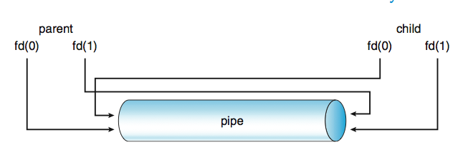
Ordinary Pipes
Ordinary pipes are used for communications between parents and children in Unix
pipe(fd) system call – where int fd[2]) creates a pipe
fd[0] is the read end
fd[1] is the write end
A parent creates a pipe and forks a child
The child inherits the pipe because pipes are treated as files (recall: child inherits the state of files of its parent)
Example: if the file is opened in the parent at time of forking, then same file will also be opened in the newly created child
Parent and child should close the unused ends of the pipe
Windows calls these anonymous pipes
Notes:
One of the first IPC mechanisms in early UNIX systems
Unix treats pipe as a special tpe of file

Slide 9
IPC Pipe Code Example
#include <sys/types.h>
#include <stdio.h>
#include <string.h>
#include <unistd.h>
#define BUFFER_SIZE 25
#define READ_END 0
#define WRITE_END 1
int main( void )
{
char write_msg[BUFFER_SIZE] = “Greetings”;
char read_msg[BUFFER_SIZE];
int fd[2];
pid_t pid;
/* create pipe */
if (pipe(fd) == -1) {
fprintf(stderr, "Pipe failed.\n");
return 1;
}
/* fork a child process */
pid = fork();
if (pid < 0) { /* error occurred */
fprintf(stderr, "Fork Failed\n");
return 1;
}
else if (pid > 0) { /* parent process */
close (fd[READ_END]);
write(fd[WRITE_END], write_msg,
strlen(write_msg)+1);
close (fd[WRITE_END]);
wait(NULL); // Wait for the child
}
else { /* child process */
close (fd[WRITE_END]);
read(fd[READ_END], read_msg, BUFFER_SIZE);
printf("Read from pipe: %s \n", read_msg);
close (fd[READ_END]);
}
return 0;
}
// close unused end of pipe
// write to pipe
// close write end of pipe
// close unused end of pipe
// read from pipe
// close the pipe
Notes:
It is important that a process reading from the pipe can detect end-of-file, i.e., read() returns 0, when the writer has closed its end of the pipe

Slide 10
Named Pipes
Named Pipes are more powerful than ordinary pipes
Communication is bidirectional
No parent-child relationship is necessary between the communicating processes
Several processes can use the named pipe for communication
Provided on both UNIX and Windows systems

Slide 11
Remote Procedure Calls

Slide 12
Remote Procedure Calls (RPC)
Abstracts procedure calls between processes on networked systems
Uses ports for service differentiation
Stubs – client-side proxy for the actual procedure on the server
The client-side stub locates the server and marshalls the parameters
The server-side stub receives this message, unpacks the marshalled parameters, and performs the procedure on the server
Data representation handled via External Data Representation (XDL) format to account for different architectures
Big-endian and little-endian
Remote communication has more failure scenarios than local
Messages can be delivered exactly once rather than at most once
OS typically provides a rendezvous (or matchmaker) service to connect client and server

Slide 13
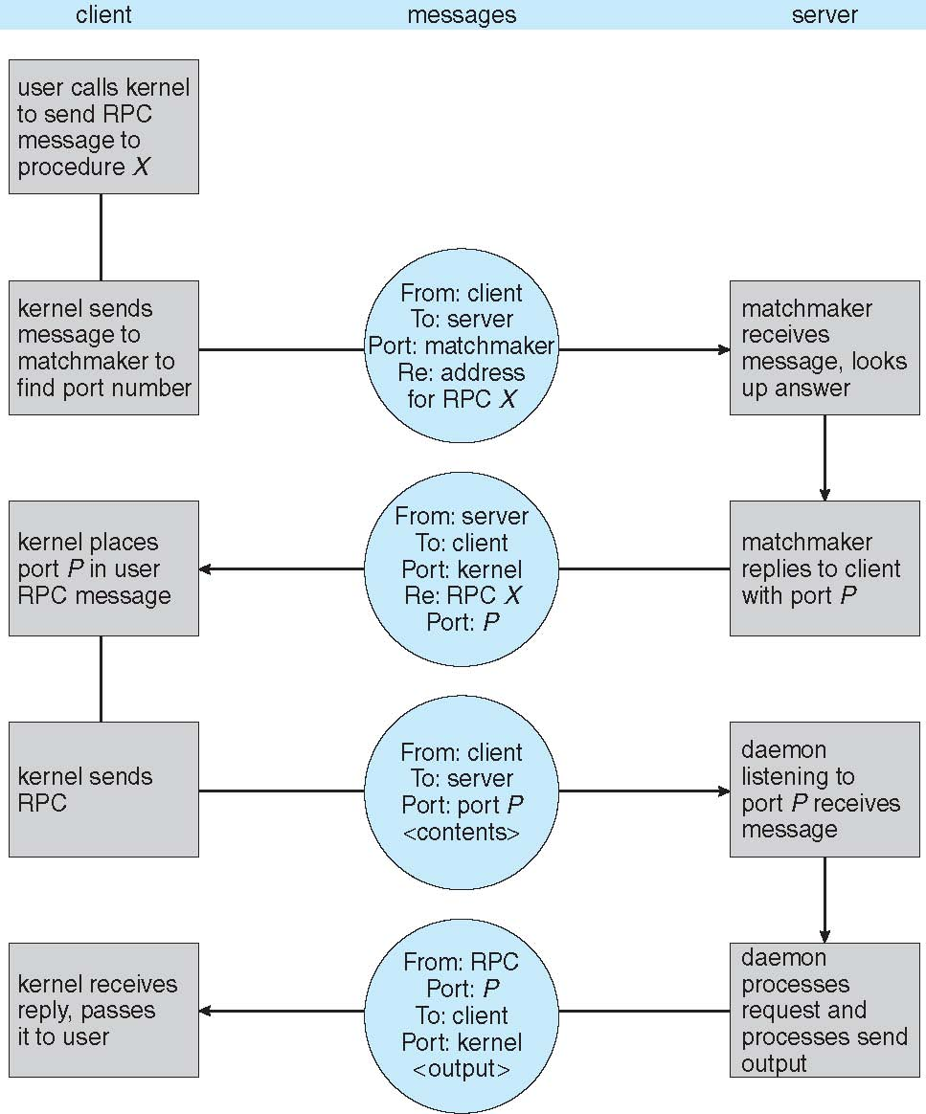
Execution of RPC

Slide 14

Chapter 4 Threads

Slide 15
Agenda
What is a thread?
Multithreading
Benefits of Threads
Threading Mechanisms
Threading Issues
Linux Operating System Example

Slide 16
Multithreading
Multithreading a program appears to do more than one thing at a time
Multithreading versus Multiprogramming
Multithreading is multitasking within a single process
Multiprogramming is multitasking across different process
For example, A word processing program has separate threads:
A thread for displaying graphics
Another thread for reading in keystrokes from the user
Another thread for performing spelling and grammar checking in the background

Slide 17
What is a Thread?
Thread: basic unit of CPU utilization
A thread consists of:
A thread ID
A program counter keeps track of which instruction to execute next
Register values store the current working variables
Stack keeps track of the program execution history
A classical process has a dedicated set of resources and a single thread of control (i.e. execution)
Multithreading allows a process to have multiple parallel threads of execution

Slide 18
Recall: One Program Two Processes
Stack
≠
Stack
(vary)
Heap
≠
Heap
Data
≠
Data
Text (i.e. binary)
=
=
Text (i.e. binary)
aProgram
aProgram’s process 1
(equivalent)
aProgram’s process 2
Notes:
User may run different copies of Word program
A process includes many things:
An address space (defining all the code and data pages)
OS descriptors of resources allocated (e.g., open files)
Execution state (PC SP regs etc)
Creating a new process is costly because of all of the data structures that must be allocated and initialized
Communicating between processes is costly because most communication goes through the OS
Inter-Process Communication (IPC)
Overhead of system calls and copying data

Slide 19
Single-threaded and Multithreaded Processes
All threads share data section, code section, and opened files
code
data
files
code
data
files
registers
Program Counter
stack
registers
registers
registers
stack
stack
stack
Program Counter
Program Counter
Program Counter
thread
thread
Single-threaded process
Multithreaded process
Each thread has its own program counter, registers, and stack
Notes:
Multithreading allows process to be subdivided into different threads of control
A thread is the smallest schedulable unit in multithreading
A process by itself can be viewed a single thread and is traditionally known as a heavy weight process

Slide 20
Why Multithread?
Key idea: if process has multiple threads, it can perform multiple tasks at a time
Example: a web server is accessed by thousands of clients simultaneously. How can we service the clients?
Single process: services clients one at a time – slow!
Multiple processes: for each client, fork a child process
Faster than a single process: multiple processes can service clients in parallel
Wasteful: if each process performs identical tasks, then why duplicate ALL process resources? (e.g. memory, as fork() does)
Multithreading: within the same server process, create a separate thread for each client
Parallelism without the overheads of resource duplication

Slide 21
Multithreaded Server Architecture

Slide 22
Benefits of Multithreading
Responsiveness: multithreaded application may continue running even if a part of the program is busy or blocked
Resource Sharing: all threads of a process share memory and resources
Economy: creating and managing a thread is faster than creating and managing a process
Most resources need not be cloned
Thread context switch is faster than a process context switch
Example: Solaris
Process creation is 30x slower than thread creation
Process context switch is 5x slower than thread context switch
Scalability: multiple threads can execute in parallel on multiple processors

Slide 23
Multicore Programming
Multicore or multiprocessor systems support
Concurrency – supports more than one task making progress
In single processor / core, CPU scheduler provides concurrency
Parallelism – performs more than one task simultaneously
Concurrency versus Parallelism
Concurrent execution on single-core system
Parallelism on a multi-core system
Notes:
Data parallelism – on dual cores, thread A running on core 0 sums elements[0] … [N/2 – 1] while thread B running on core 1 sums elements[N/2] … [N-1]
Task parallelism – 2 threads, each performs a unique statistical operation on the array of elements

Slide 24
Multicore Programming (2)
Types of parallelism
Data parallelism – distributes subsets of the same data across multiple cores and performs same operation on each core
Task parallelism – distributing threads across cores, each thread performing unique operation
As number of threads grows, so does architectural support for threading
CPUs have cores as well as hardware threads
Oracle SPARC T4 with 8 cores, and 8 hardware threads per core
Notes:
Data parallelism – on dual cores, thread A running on core 0 sums elements[0] … [N/2 – 1] while thread B running on core 1 sums elements[N/2] … [N-1]
Task parallelism – 2 threads, each performs a unique statistical operation on the array of elements

Slide 25
Multicore Programming (3)
Multicore systems place pressure on system designers and application programmers
OS designers should support parallel execution on multiple cores
Application developers should design and implement multithreaded programs
Programming Challenges
Identifying tasks: how can we split our program into a set of concurrent tasks?
Balance: how can we fairly divide the workload among multiple tasks?
Data splitting: how can the data be split among multiple tasks?
Data dependency: if task T₂ depends on the data from task T₁, then T₁ and T₂ must be properly synchronized
Testing and debugging: much harder than with a single thread!

Slide 26
Multithreading Models
Support for multiple threads may be provided at either the user level or by the kernel
User threads – supported and managed without intervention from the OS
POSIX Threads (Pthreads)
Windows Threads
Java Threads
Kernel threads – supported and managed directly by the OS
Windows
Linux
Mac OS X
Solaris
Some relationship must exist between user threads and kernel threads

Slide 27
Many-to-One Multithreading Model
Many user-level threads are mapped to a single kernel thread
User thread
K
Kernel thread
User-level library manages the threads – efficient
If one user-level thread makes a system call, then all threads block while the system call is serviced
Threads cannot run concurrently on multiple processors because only one thread can access the kernel at a time
Examples: Green threads (Solaris), early Java
Very few systems continue using this model due to its inability to take advantage of multiple processing cores

Slide 28
One-to-One Multithreading Model
Maps a single user thread to a single kernel thread
User thread
K
K
K
K
Kernel thread
Other threads can continue execution even if one thread blocks on a system call
Enables concurrent execution of threads on multiple cores
Drawback: creating a user thread requires creating a kernel thread
The overhead of creating kernel threads is high
Maximum number of threads is usually limited – too many threads many burden the application performance
Windows and Linux implement the one-to-one model

Slide 29
Many-to-Many Multithreading Model
Multiplexes many user-level to smaller or equal number of kernel-level threads
User thread
Many-to-Many
Two-level Mode
K
K
K
Kernel thread
K
Enables threads to run concurrently on multiple processors
When a caller thread calls on a blocking system call, kernel can schedule another thread for execution
Two-level model
Similar to many-to-many but also allows a user-level thread to be bound to a kernel thread
Versions older than Solaris 9 supported the two-level model

Slide 30
Multithreading Models Comparison
Many-to-one
User can create any number of threads
No true concurrency – only one kernel thread runs at a time
One-to-one
Results in true concurrency
The overhead of creating a thread is high
Most implementations limit the number of threads
Many-to-Many
Aims to get the best of both worlds

Slide 31
Thread Libraries

Slide 32
Thread Libraries
Provide an API for creating and managing threads
Two implementation approaches
In user space: invoking an API function does not result in a system call (because no OS intervention needed) – fast!
In kernel space: invoking an API function call results in a system call
Three dominant libraries
POSIX threads (pthreads): can either be user- or kernel-level
POSIX (IEEE 1003.1c) API for thread creation and synchronization
Windows: kernel-level library for windows
Java: allows threads to be created and managed directly in Java programs
Underlying implementation uses Windows API library for Windows and Pthreads API in Unix/Linux

Slide 33
Pthreads Library
Pthreads – POSIX specification for thread behavior (not an implementation!)
pthread_t tid declares a pthread identifier
pthread_attr_t attr declares a set of thread attributes
pthread_attr_init(&attr) gets the default thread attributes
pthread_create(&tid, &attr, runner, &arg) creates the actual thread
tid: the identifier of the thread
attr: the set of thread attributes
runner: the function a thread should execute (runner())
arg: the argument to pass to the function
pthread_join() is used by a parent thread to wait for a child thread to complete
pthread_exit() terminates the calling thread

Slide 34
Pthreads Example
A program using Pthreads to compute a sum of n consecutive integers starting with 0
#include <pthread. h>
#include <stdio. h>
int sum; /* this data is shared by the thread(s) */
void *runner(void *param); /* the thread */
int main(int argc, char *argv[] )
{
pthread_t tid; /* the thread identifier */
pthread_attr_t attr; /* set of thread attributes */
if (argc ! = 2) {
fprintf(stderr, "usage: a. out <integer value>\n");
return -1;
}
if (atoi(argv[1] ) < 0) {
fprintf(stderr, "%d must be >= 0\n", atoi(argv[1] ));
return -1;
}
/* get the default attributes */
pthread_attr_init(&attr);
/* create the thread */
pthread_create(&tid, &attr, runner, argv[1] );
/* wait for the thread to exit */
pthread_join(tid, NULL);
printf("sum = %d\n", sum);
} //End of main()
/* The thread will begin control in this function */
void *runner(void *param)
{
int i, upper = atoi(param);
sum = 0;
for (i = 1; i <= upper; i++) {
sum += i;
}
pthread_exit(0);
}

Slide 35
Pthreads Code for Joining 10 Threads

Slide 36
Thread Libraries: Windows and Java
Conceptually similar to Pthreads

Slide 37
Implicit Threading

Slide 38
Implicit Threading
Transfers the creation and management of threads to compilers and run-time libraries rather than programmers
Alternative approaches for designing multithreaded programs that can take advantage of multicore processors
Thread Pools
OpenMP
Other parallel and concurrent approaches
Grand Central Dispatch
Apple technology for Mac OS X and iOS operating systems
Intel’s Threading Building Blocks (TBB)
Java language and API with concurrent programming support such as java.util.concurrent package
Several products from Microsoft

Slide 39
Thread Pools
Basic idea: create a number of threads and place them into the pool, where they sit and wait for work
When a work request comes in, a thread from the pool services the request and returns to the pool
Advantages
Servicing a request with an existing thread is usually faster than the overhead of creating a new thread
A thread pool limits the number of threads that exist at any one point to prevent resource exhaustion

Slide 40
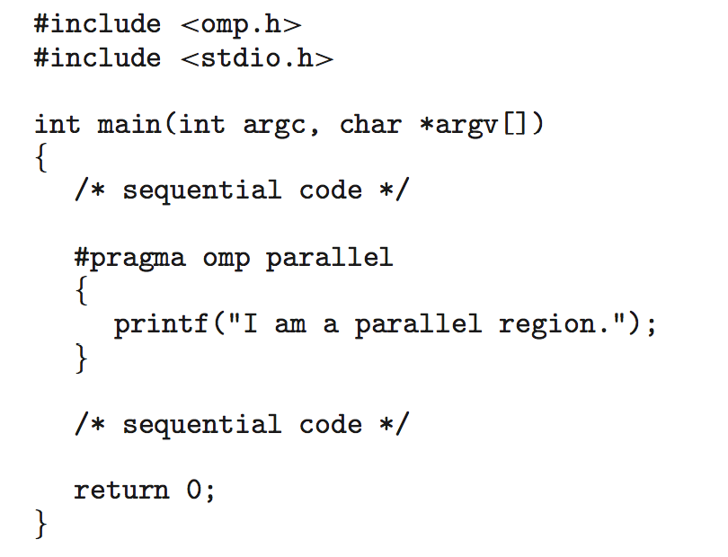
OpenMP
Set of compiler directives and an API for C, C++, or FORTRAN
Provides support for parallel programming in shared-memory environments
Identifies parallel regions – blocks of code that can run in parallel
#pragma omp parallel
Example: Run for loop in parallel
#pragma omp parallel for for(i = 0;i < N; i++) {
c[i] = a[i] + b[i];
}
Create as many threads as there are cores

Slide 41
Thread Issues

Slide 42
fork() and exec() System Calls
Recall: fork() system call duplicates the entire process
If one thread calls fork(), do we duplicate all threads in a process? Is the forked process single threaded?
exec() – If a thread calls exec(), the program specified in the parameters to exec() will replace the entire process including all threads
Two versions of fork() in Unix
Duplicates all threads
If the separate process does not call exec() after forking, the separate process should duplicate all threads
Duplicates only the caller thread
If exec() is called immediately after forking, only the calling thread is duplicated since the program specified in the parameters to exec() will replace the process

Slide 43
Signal Handling
Signal: used in Unix to notify a process that a particular event has occurred
A signal can be either synchronous or asynchronous
Synchronous: signal resulting from the process operations
For example, illegal memory access or division by 0
Asynchronous: signal generated by the event outside of the process
For example, user pressing <Ctrl+C>
A signal handler is used to process signals
A signal is generated by a particular event
A generated signal is delivered to a process
Once delivered, the signal must be handled
Signal can be handled by a default handler or a user-defined handler

Slide 44
Signal Handling (cont)
Every signal has default handler that kernel runs when handling signal
User-defined signal handler can override default
For single-threaded, signal delivered to process
Signal handling options in multithreaded processes
Deliver the signal to the thread to which the signal applies
For example, synchronous signals need to delivered to the thread causing the signal, not the other threads in the process
Deliver the signal to every thread in the process
For example, asynchronous signal to terminate a process (e.g., <Ctrl+C>) should be sent to all threads
Deliver the signal to certain threads in the process
Assign a specific thread to receive all signals for the process

Slide 45
Thread Cancellation
Terminating a thread before it has completed its task
Thread to be cancelled is referred to as target thread
Two general approaches
Asynchronous cancellation: a thread is terminated immediately upon request
Problem: terminated thread may not get a chance to release allocated resources
Deferred cancellation: a thread periodically checks whether it should exit
Allows a thread to release its resources prior to exiting
Pthread code to create and cancel a thread
pthread_t tid; /* the thread identifier */
/* create the thread */
pthread_create(&tid, 0, worker, NULL);
/* … */
/* create the thread */
pthread_cancel(tid);

Slide 46
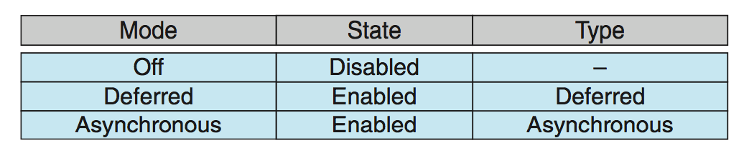
Thread Cancellation (cont)
Invoking pthread_cancel() only requests the target thread to be cancelled
Actual cancellation depends on thread state
If thread has cancellation disabled, cancellation remains pending until thread enables it
Default mode is deferred
Cancellation only occurs when thread reaches cancellation point
pthread_testcancel()is invoked to establish a cancellation point
Then cleanup handler is invoked if the cancellation request is pending
On Linux systems, thread cancellation is handled through signals

Slide 47
Thread-Specific Data
Threads belonging to a process share the data of the process
Thread specific data: data belonging exclusively to the thread i.e., not shared with other threads
Thread-local storage (TLS) allows each thread to have its own copy of data
Useful when you do not have control over the thread creation process (i.e., when using a thread pool)
Different from local variables
Local variables visible only during single function invocation
TLS visible across function invocations
Similar to static data
TLS is unique to each thread

Slide 48
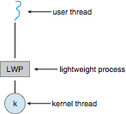
Scheduler Activations
M:M and Two-level models require communication to maintain the appropriate number of kernel threads allocated to the application
Typically use an intermediate data structure between user and kernel threads – lightweight process (LWP)
Appears to be a virtual processor on which process can schedule user thread to run
Each LWP attached to kernel thread
Scheduler activations provide upcalls - a communication mechanism from the kernel to the upcall handler in the thread library
This communication allows an application to maintain the correct number kernel threads

Slide 49
Thread Example

Slide 50
Linux Operating System Example
Linux kernel does not distinguish between processes and threads! Both are referred to as tasks
Provides the ability to create threads with the clone() system call
clone() system call takes a set of flags as arguments that decide how much sharing takes place between the parent and child tasks
Flags control behavior
struct task_struct points to process data structures (shared or unique)

Slide 51
References
Operating System Concepts, 9th Edition, Abraham Silberschatz, Peter Baer Galvin, Greg Gagne
Chapters 3 and 4

